Slide 1
OPPORTUNITY IDENTIFICATION AND SELECTION-UNIT-II
Ms. Khushboo Kalra
Assistant Professor
PIET

Slide 2
Introduction/Definition of concepts

Slide 3
Opportunity Search and Identification
Opportunity is a major process of self-evaluation of one’s ability to start, operate and run a business venture with the popular analysis often referred to as SWOT (Strength, Weaknesses, Opportunity and Threat). It helps to check the chances of succeeding in a particular choice of venture open to an individual through his experiences.

Slide 4
S = Strengths
W = Weaknesses
O = Opportunities
T = Threats

Slide 5
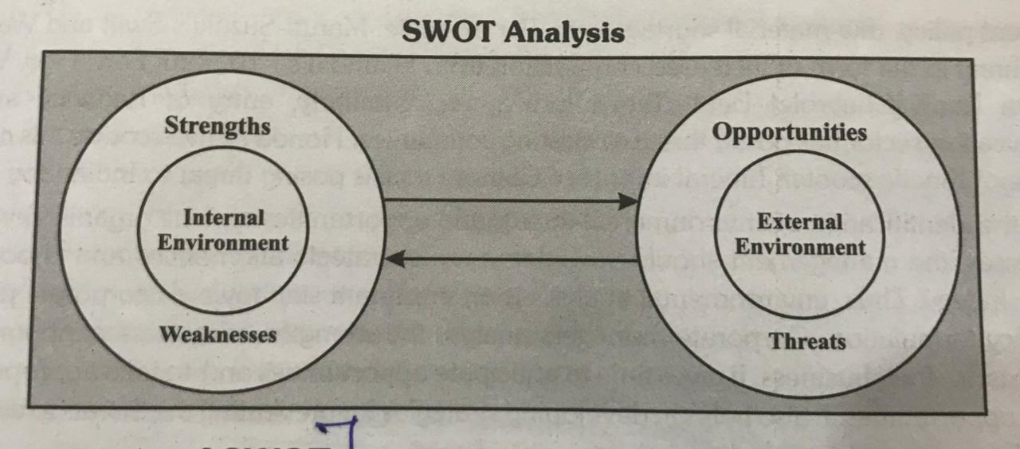
SWOT Analysis is undertaken by business firms to understand their external and internal environment.
SWOT analysis is applied to formulate effective organizational strategies.

Slide 6
New startups always focus on introducing a new product or service based on an unmet need, select an existing product or service from one market and offer it in another where they are not available; and sometimes the firm relies on a tried and tested formula that has worked elsewhere in a franchise setup.

Slide 7
Business Opportunity Identification Process
It is pertinent to know how entrepreneurs identify and decide a new business opportunity with the best chance to succeed. The most important part of all business attempts common to most successful startups is answering an unmet need in the market. Customers are always interested in products that add value.

Slide 8
IDEA GENERATION
Sources of Ideas:
In a sense, opportunity identification and selection are akin to, what is termed in marketing terminology, ‘new product development.’ Thus, product or opportunity identification and selection process starts with the generation of ideas, or say, ideas about some opportunities or products are generated in the first instance.

Slide 9
(i) Knowledge of potential customer needs.
(ii) Watching emerging trends in demands for certain products,
(iii) Scope for producing substitute product.
(iv) Going through certain professional magazines catering to specific interests like electronics, computers, etc.,
(v) Success stories of known entrepreneurs or friends or relatives.
(vi) Making visits to trade fairs and exhibitions displaying new products and services.
(vii) Meeting with the Government agencies.
(viii) Ideas given by the knowledgeable persons.
(xi) A new product introduced by the competitor.
(x) One’s market insights through observation.

Slide 10
CONSUMERS
No business enterprise can be thought of without consumers. Consumers demand for products and services to satisfy their wants. Also, consumers’ wants in terms of preferences, tastes and liking keep on changing. Hence, an entrepreneur needs to know what the consumers actually want so that he/she can offer the product or service accordingly. Consumers’ wants can be known through their feedback about the products and services they have been using and would want to use in future.

Slide 11
EXISTING PRODUCTS AND SERVICES
One way to have an enterprise idea may be to monitor the existing products and services already available in the market and make a competitive analysis of them to identify their shortcomings and then, based on it, decide what and how a better product and service can be offered to the consumers

Slide 12
DISTRIBUITION CHANNEL
Distribution channels called, market intermediaries, also serves as a very effective source for new ideas for entrepreneurs. The reason is that they ultimately deal with the ultimate consumers and, hence, better know the consumers’ wants.
As such, the channel members such as wholesalers and retailers can provide ideas for new product development and modification in the existing product.

Slide 13
GOVERNMENT
At times, the Government can also be a source of new product ideas in various ways. For example, government from time to time issues regulations on product production and consumption. Many a times, these regulations become excellent sources for new ideas for enterprise formation.

Slide 14
RESEARCH & DEVELOPMENT
The last but that does not means the least source of new ideas is research and development (R&D) activity. R&D can be carried out in-house or outside the organization. R&D activity suggests what and how a new or modified product can be produced to meet the customers’ requirements.

Slide 15
The Stages of Opportunity Identification process
Preparation
Incubation
Insight
Evaluation
Elaboration

Slide 16
THANK YOU ☺

